Slide 1
Lecture 2: Welcome to Programming I!
Reading: Chapter 1, Sections 1.7 - 1.10
JGrasp, Simple Java Programs and Programming Errors

Slide 2
What you need for your first Java program
We will be using JGrasp.
JGrasp is a simple integrated development environment (IDE) that allows you to write Java programs, compile and execute them.
JGrasp is available on NEIU lab computers.
You can download JGrasp for your personal PC here: http://spider.eng.auburn.edu/user-cgi/grasp/grasp.pl?;dl=download_jgrasp.html
If you have a Windows machine, you will need to install the JDK with Java version 1.5 (JDK 5) or higher. Please see the News Items section of the course website for help/instructions.

Slide 3
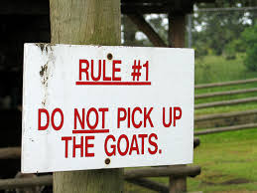
The Rules
In your program, at the very beginning, you shall have: public class class-name
In your program, directly following the above, you shall have (and it shall be indented). public static void main(String[] args)
And you shall save the file with the same class-name as above, but with .java as the extension.
And there shall be braces: {}
And if you forget any of the above, there shall be errors!!

Slide 4
Your first Java program!
This program should be saved as MyFirstProgram.java Capitalization MUST match
Rule #1
public class MyFirstProgram {
public static void main(String[] args) {
}
}
Rule #2
These are the inner braces. Everything else must go inside these two braces.
These are the outer braces - they hold the whole program

Slide 5
Some notation
class name and the file name can be whatever you want, but they must match!
public class MyFirstProgram {
public static void main(String[] args) {
}
}
the main method - required for EVERY program. Memorize this!!!

Slide 6
Blocks
Next line braces
End-of-line braces
public class MyFirstProgram {
public static void main(String[] args) {
}
}
public class MyFirstProgram {
public static void main(String[] args) {
}
}
These two sets of code are the same
A block is a group of statements surrounded by braces.

Slide 7

What does this program do?
public class MyFirstProgram {
public static void main(String[] args) {
}
}

Slide 8
Simple print statements
public class MyFirstProgram {
public static void main(String[] args) {
System.out.println(“This is my first program!”);
}
}
You must have: System.out.println with parentheses.
Whatever you want to print out must be in quotes.
You MUST have a semicolon at the end of the statement.

Slide 9
jGrasp Example
We will be using jGrasp in class since the school computers have jGrasp installed.
Under the News Items section for the CS-200 website, there are instructions on how to install jGrasp and the Java JDK (if needed) for your operating system (Mac vs Windows).
Attention Mac users! If jGrasp version 2.0.0_15 does not work for you, first try 2.0.0_16 (Beta version) and then try 2.0.1 (Alpha)

Slide 10
Open jGrasp
public class MyFirstProgram
{
}
Click on File and choose
New ⟶ Java.
Click on File and choose
Save As.
You MUST save your program with the same name as whatever follows the word “class”. In this case it should
be MyFirstProgram.java

Slide 11
Indentation is important!
It makes it easier to read.
For every opening brace, there is a closing brace.
What you want to print out should be inside the quotes.
There must be a semicolon at the end of the println statement.

Slide 12
You should see two things: 1. A .class file 2. Output that says “Operation Complete”
In order to make this program work, we need to compile it first. Press the green + button to compile your program.
This is the output/console window. It’s where you will
see errors and output from print statements

Slide 13
The words inside the quotes got printed out to the output window!
In order to run (or execute) this program, we need to press the red running man.
This tell you your program is done.

Slide 14


Slide 15
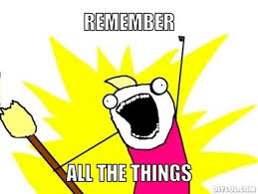
Remember...
You must have public class class-name with opening and closing braces.
You must have public static void main(String[] args) with opening and closing braces (Your program WON’T run without this!! Memorize it!!!).
Your print statement must have a semi-colon at the end of it.

Slide 16
Indentation
Indentation makes programs clear and easy to read, debug and maintain.
It is used to illustrate the structural relationships between a program’s components.
Java doesn’t need indentation - it all gets compiled regardless. However, we, the programmers need indentation.
public class TestProgram {public static void main(String[] args){System.out.
println(“I’m writing a program.”); System.out.
println(“And it needs to be properly indented.”); System.
out.println(“So that I know what it does!”);}}
public class TestProgram
{
public static void main(String[] args)
{
System.out.println(“I’m writing a program.”);
System.out.println(“And it needs to be properly indented.”);
System.out.println(“So that I know what it does!”);
}
}

Slide 17
Each statement after that is indented.
Each brace goes on its own line
A semi-colon means start a new line.
public class TestProgram
{
public static void main(String[] args)
{
System.out.println(“I’m writing a program.”);
System.out.println(“And it needs to be properly indented.”);
System.out.println(“So that I know what it does!”);
}
}
You match braces starting with the inner-most brace
And then work your way outward.

Slide 18
Spacing
Spacing is important as well as it helps you to be able to read your program.
Bad spacing: System.out.println(3+4*4);
Good spacing: System.out.println(3 + 4 * 4);

Slide 19
Comments
Sometimes, you don’t want a statement in your program to be executed/run.
There is a special way to indicate lines or groups of lines that you do not want to be executed. These are called comments.
Comments should be used at the beginning of the program to explain who wrote the program and what it does. In your book and sometimes in other people’s programs, you will see comments throughout the code. Don’t do this!!!
Code should be written with clear names so that you don’t need comments to explain your code.

Slide 20
// Author: Rachel Trana
// This is a program that shows proper indentation.
// These are line comments and they comment out one line at a time.
public class TestProgram
{
public static void main(String[] args)
{
System.out.println(“I’m writing a program.”);
System.out.println(“And it needs to be properly indented.”);
System.out.println(“So that I know what it does!”);
}
}
/* Author: Rachel Trana
This is a program that shows proper indentation.
These are block comments and they comment out a group of lines. */
public class TestProgram
{
public static void main(String[] args)
{
System.out.println(“I’m writing a program.”);
System.out.println(“And it needs to be properly indented.”);
System.out.println(“So that I know what it does!”);
}
}

Slide 21
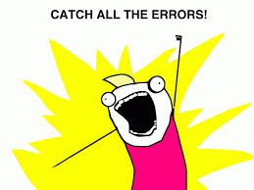

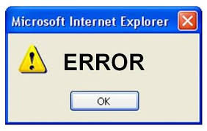
Errors

Slide 22
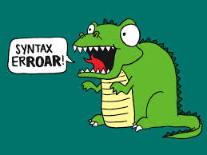
Syntax Errors
Errors that are detected by the compiler.
Result from errors in code construction, such as mistyping a keyword, omitting necessary punctuation, or using an opening brace without a closing brace.
These are usually easy to find because the compiler tells you where they and what caused them.

Slide 23
Missing the word void!

Slide 24
Shows 3 errors, but if you fix the quotation then it’s all ok.

Slide 25
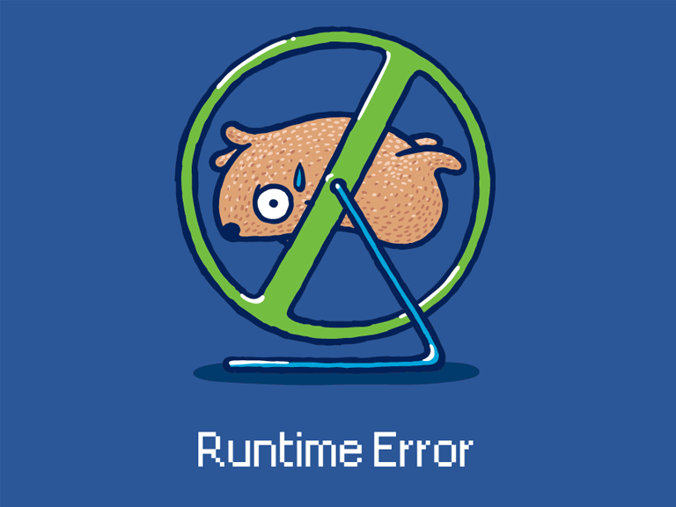
Runtime Errors
Errors that cause a program to exit abnormally.
Result from something happening in the program that is impossible to do.
You will typically see something in your output window that says “Exception in thread.”

Slide 26
Says “Exception in thread”.

Slide 27
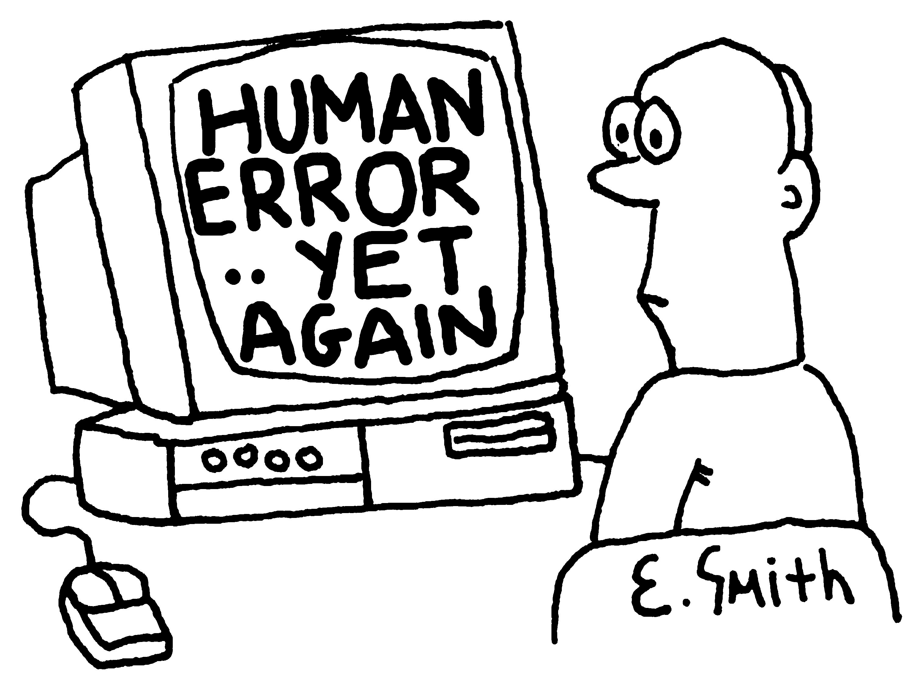
Logic Errors
Errors that occur when a program does not perform the way you intended it to.
These are also called human errors because they occur due to the programmer not coding the logic for a program properly.
These are much harder to find because you have to understand what your output should look like.

Slide 28
My bad. The decimal point is in the wrong place. Human error.

Slide 29
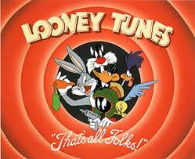
That’s all for today folks!
Read Chapter 1, Sections 1.7 - 1.10. Your homework is posted on the course website under Assignments and is due Wednesday, 09/03/14.
Submit via the D2L dropbox in a .zip folder

